Slide 1

TECHNOVA 2026 · PARTICIPANT PITCH
AI-Powered Underground Mine Safety & Rescue
TEAM
Suraksha Kavach
Disaster Management · Maulana Abul Kalam Azad University of Technology,WB
Organized by GSA MAKAUT × WebCraftzs Technologies
Notes:
Template tip: replace every [bracket] with your own content. Keep the deck to 10 slides and your pitch to about 5 minutes.
1

Slide 2
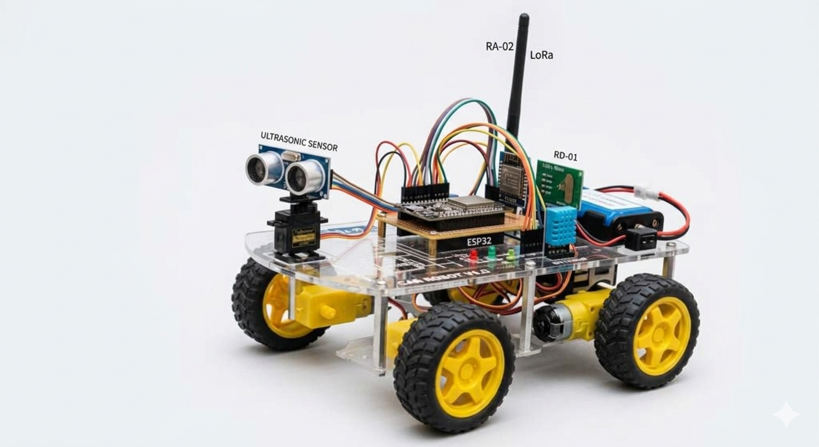



01 · THE PROBLEM
When a mine emergency cuts off cellular connectivity, a fallen or trapped worker may go unnoticed and rescuers may not know the underground conditions.
Who is affected
How big it is
Why today's options fall short
Underground miners and rescue teams working in areas affected by falls, gas hazards or landslides.
Example scenario: a worker falls or a landslide blocks access while cellular coverage is unavailable.
Cellular-dependent alerts may fail underground; responders may lack immediate information about the worker’s condition and the mine environment.
TECHNOVA 2026 · Team Name TBD · GSA MAKAUT × WebCraftzs Technologies
02
Notes:
Spend about 40 seconds here. Make the judges feel the problem before you show the fix.
2

Slide 3
02 · THE SOLUTION
A smart helmet sends emergency alerts over an RFM02-based LoRa mesh to a control-room dashboard, prompting a robot to assess the mine.
What it does
What makes it different
  Helmet-based fall/impact detection using MPU6050
  Gas-risk and environment monitoring using MQ135 and DHT11
  LoRa alerts, dashboard monitoring and robot-assisted assessment
  Designed for areas without cellular connectivity
  Combines worker alerts with on-site robotic assessment
  Uses a sensor-equipped helmet and a motor-driven robot
TECHNOVA 2026 · Team Name TBD · GSA MAKAUT × WebCraftzs Technologies
03
Notes:
One sentence first, then three features at most. Keep the language simple enough for a non-technical judge.
3

Slide 4
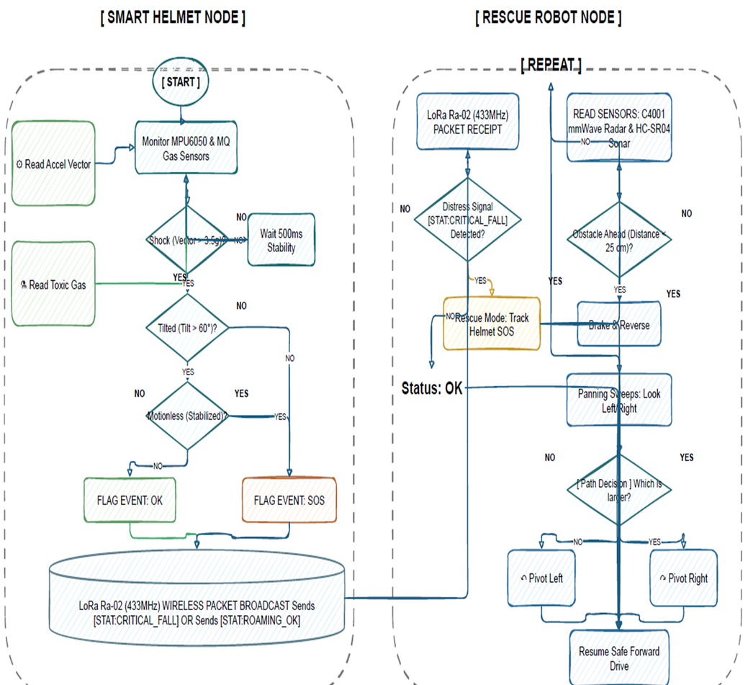
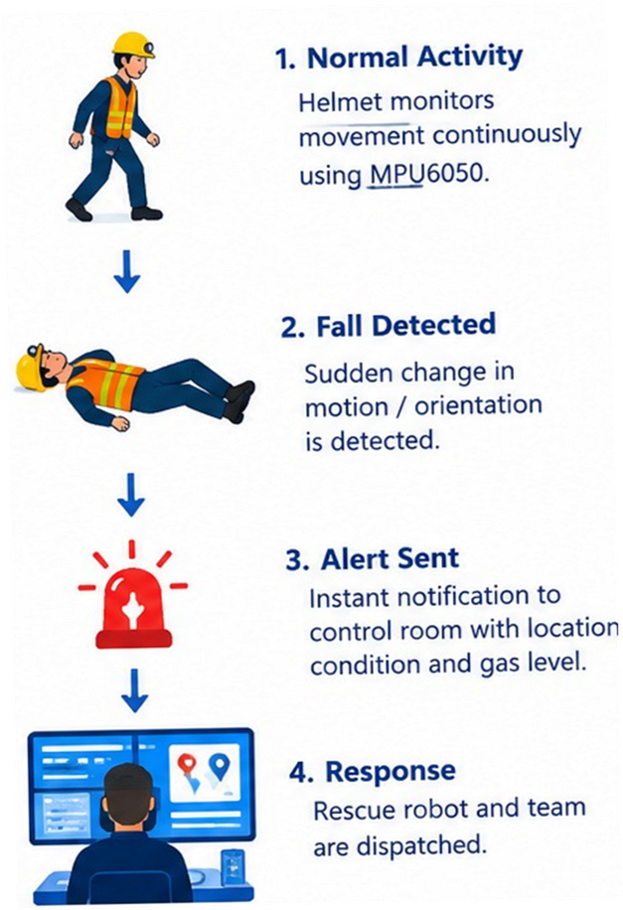

03 · HOW IT WORKS
STEP 1
From input to impact
Helmet sensing
MPU6050 detects a sudden impact/fall; MQ135 and DHT11 monitor gas-risk and environmental conditions.
STEP 2
LoRa mesh alert
RFM02 sends the alert to the control-room dashboard even when cellular data is unavailable.
STEP 3
Robot assessment
The robot checks mine conditions; radar supports a search for trapped people after a landslide. Gas hazards prompt a safe ventilation response.
TECHNOVA 2026 · Team Name TBD · GSA MAKAUT × WebCraftzs Technologies
04
Notes:
Replace the three steps with your real flow, or swap them for an architecture diagram.
4

Slide 5
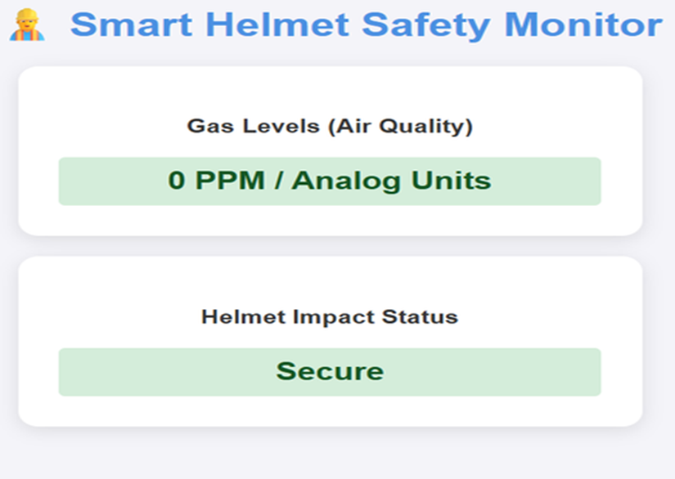
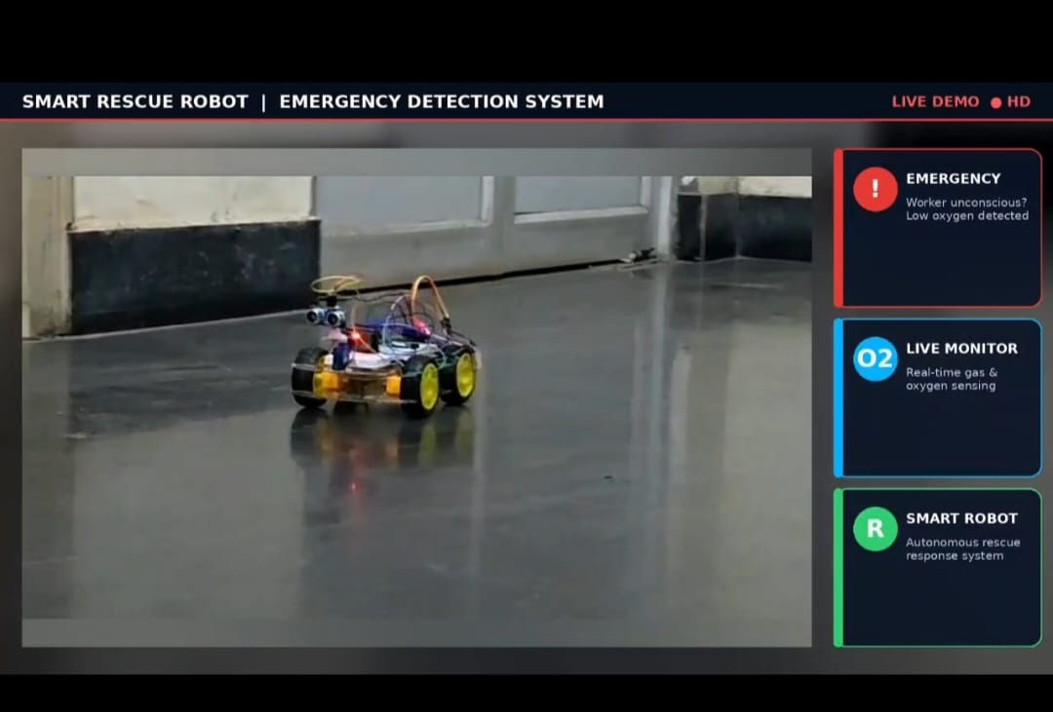
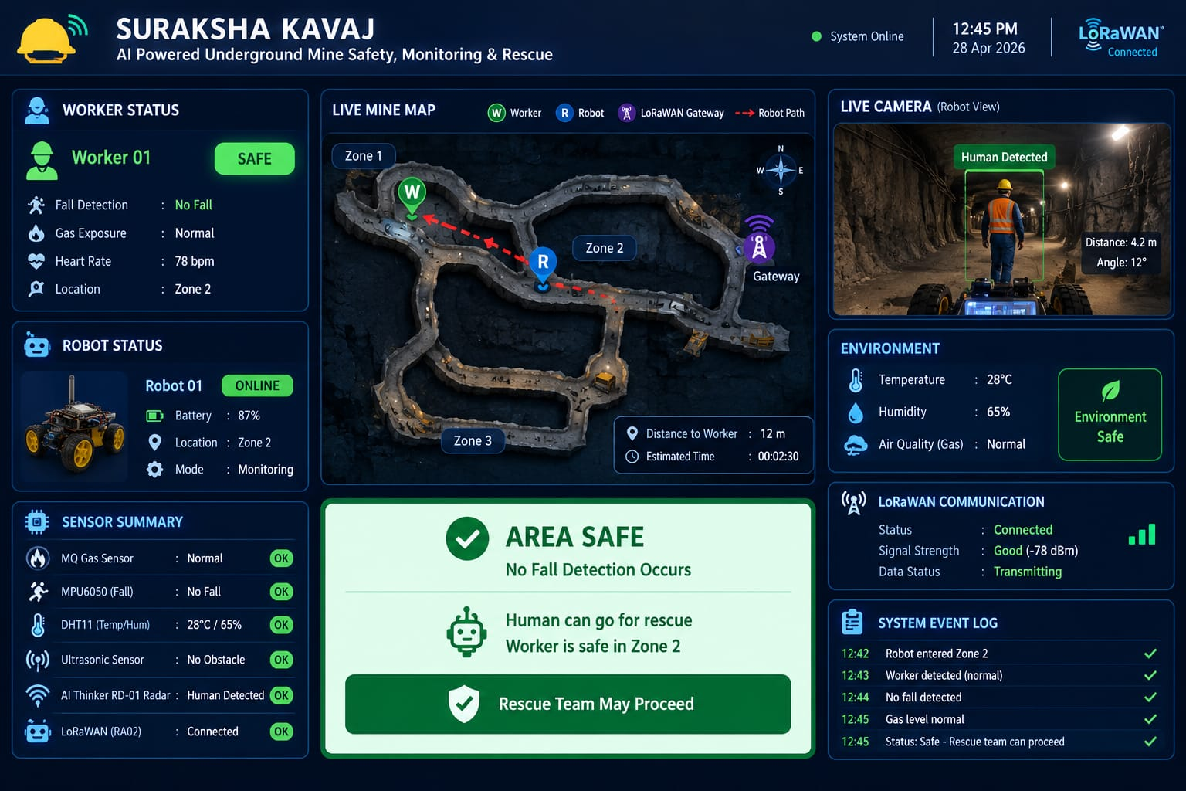

04 · DEMO
See it in action
Control-room dashboard
Robot deployment
Search after landslide
Radar-assisted search to help identify whether a person may be trapped.
Radar-assisted search to help identify whether a person may be trapped.
Radar-assisted search to help identify whether a person may be trapped.
TECHNOVA 2026 · Team Name TBD · GSA MAKAUT × WebCraftzs Technologies
05
Notes:
Drop in real screenshots or a demo video link. Show the main journey, not every feature.
5

Slide 6
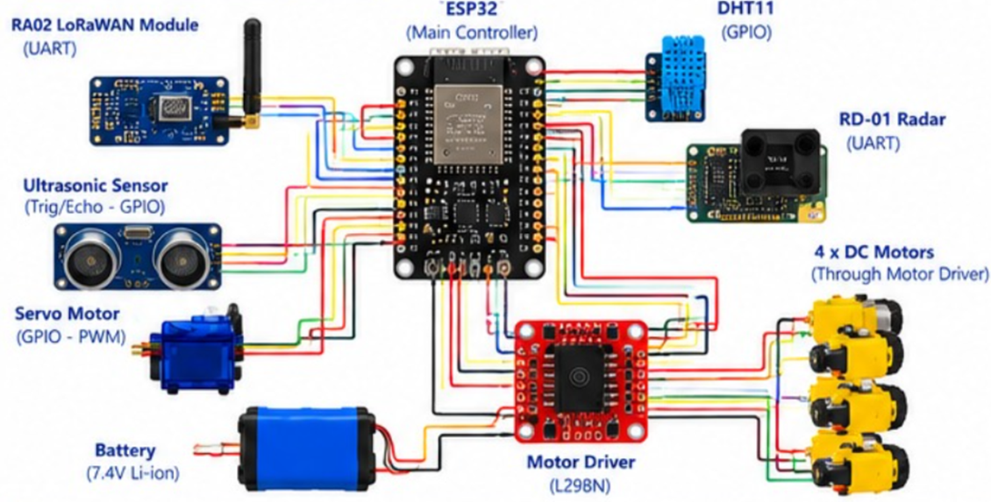
05 · TECH STACK
What we built it with
Layer | Technology | Why we chose it
Helmet sensors | MPU6050, MQ135, DHT11 | Fall/impact and environment monitoring; validate gas sensing for methane-specific use.
Communication | RFM02 / LoRa mesh | Carries alerts when cellular data is unavailable.
Rescue robot | Radar + L298N motor driver | Radar-assisted search; L298N drives the robot motors.
Control room | Dashboard | Displays alerts and supports response coordination.
TECHNOVA 2026 · Team Name TBD · GSA MAKAUT × WebCraftzs Technologies
06
Notes:
Be honest about what you built during the event and what you reused.
6

Slide 7
06 · IMPACT
REAL-TIME
Emergency alerts designed for mines without cellular coverage.
Helps control-room staff respond to fall alerts, investigate gas-risk conditions and coordinate a more informed search after a landslide. Impact figures will be measured during testing.
TECHNOVA 2026 · Team Name TBD · GSA MAKAUT × WebCraftzs Technologies
07
Notes:
Use one real, verifiable figure from a pilot, survey or research. If you have none, describe the change in plain words instead.
7

Slide 8
07 · ROADMAP
Where we go next
01
02
03
During the hackathon
Next 3 months
Next 12 months
  Run controlled tests for gas-risk and environmental readings
  Test robot movement, radar search and alert reliability
  Integrate helmet sensors, RFM02 alert transmission and dashboard display
  Test fall/impact alerts and message delivery
  Improve mesh coverage and multi-node communication
  Validate sensors and rescue workflow in realistic mine-like conditions
TECHNOVA 2026 · Team Name TBD · GSA MAKAUT × WebCraftzs Technologies
08
Notes:
Keep it realistic. Two clear goals per stage beat a long wish list.
8

Slide 9

08 · THE TEAM
SURAKSHA KAVACH
Anindita Porel
Nilakshi chatterjee
Dibyani Dey
Manami Dey
Hardware
Code
Sensors
Hardware
MAKAUT,WB
GNIT,WB
GNIT,WB
MAKAUT,WB
TECHNOVA 2026 · Team Name TBD · GSA MAKAUT × WebCraftzs Technologies
09
Notes:
Delete a card if your team has fewer than four members.
9

Slide 10
SHUBHO PUJO · QUESTIONS?
Thank You
GitHub: Add project repository
Live demo: https://drive.google.com/file/d/1Bjd7bHP86O694pYUqhah5WCz2rY6a6zi/view?usp=sharing
Contact: sumantasarathisarkar@gmail.com
TECHNOVA 2026 · GSA MAKAUT × WebCraftzs Technologies
Notes:
End with your links and be ready for questions. Thank the organizers and the judges.
10

